Slide 1
OPTIMISATION OF PARTS GROUP P
TOPOLOGY OPTIMISATION OF MONITOR WALL MOUNTING
RUSHAL KALKURA - 244618
SHASHANK PAWAR ESHWARA - 244334
ROSHAN PRUTHVISH ASHOKAN – 244381
Nithin KANIKYASWAMY– 244669
YATHISH NAGARAJ – 244509
YASHWANTH MADHU - 244380
17-01-2023
Winter Semester 2022/23

Slide 2
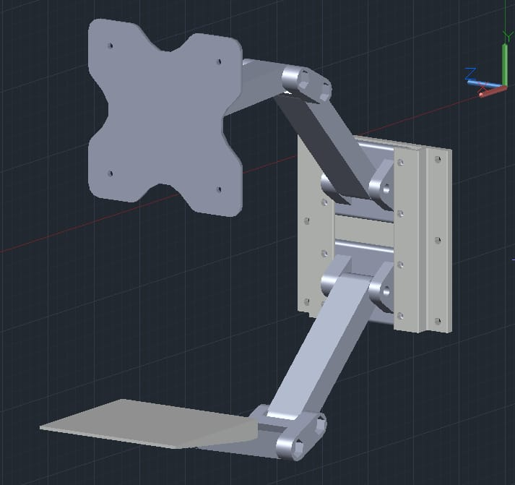
ASSEMBLY IMAGE
1

Slide 3
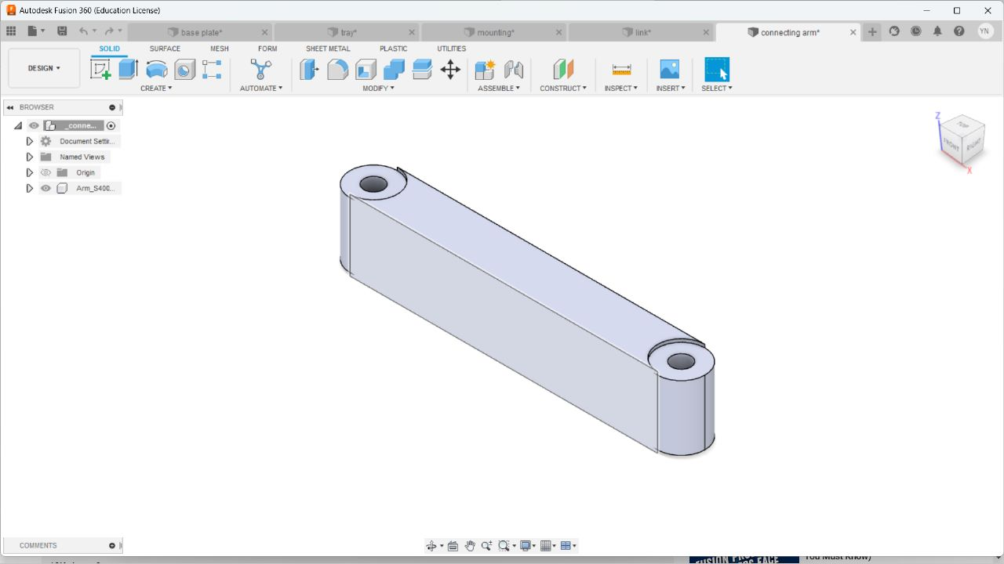
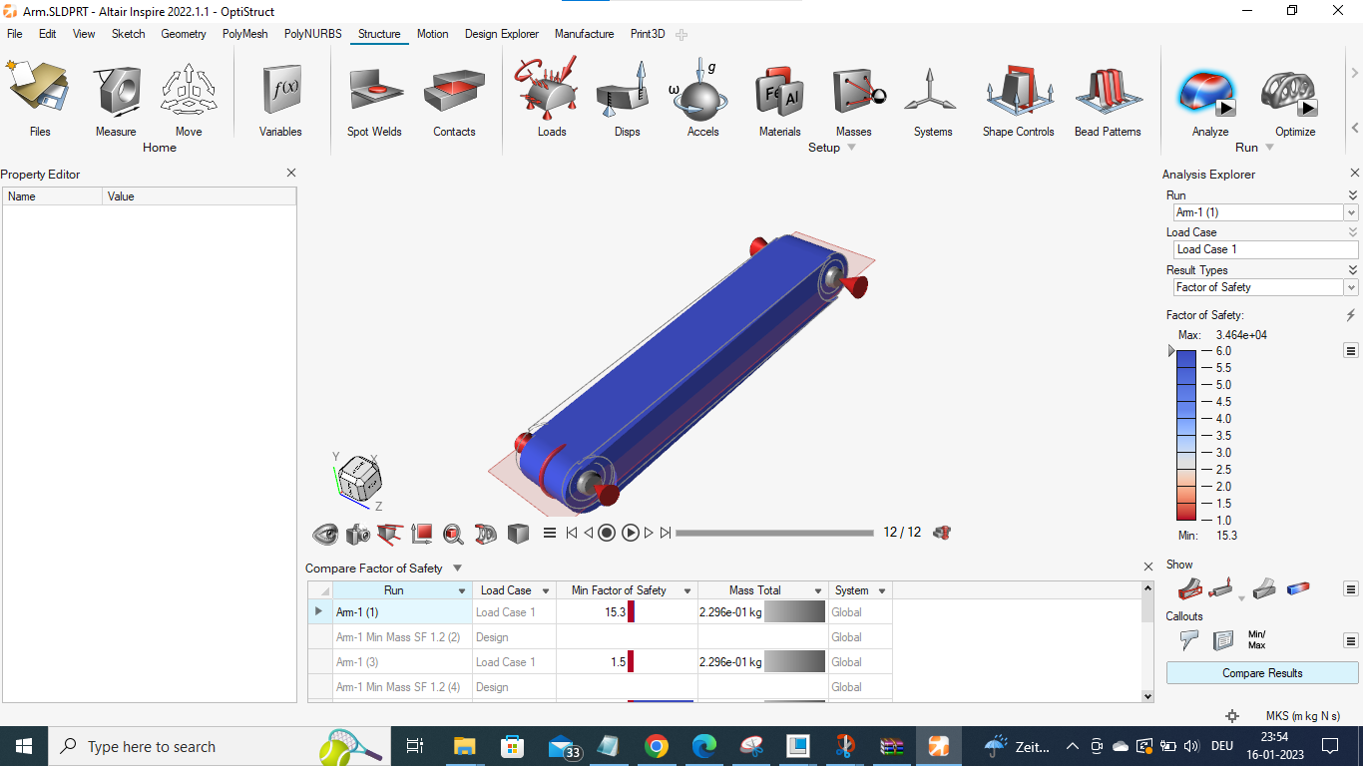
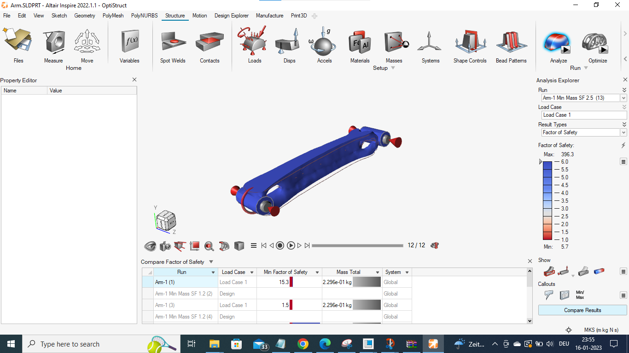
ARM’S TOPOLOGY OPTIMISATION
Material Type : Aluminium 2024 Result After optimization: Decrease in mass by 65.16%.
Initial Weight:
Final Weight:
2

Slide 4
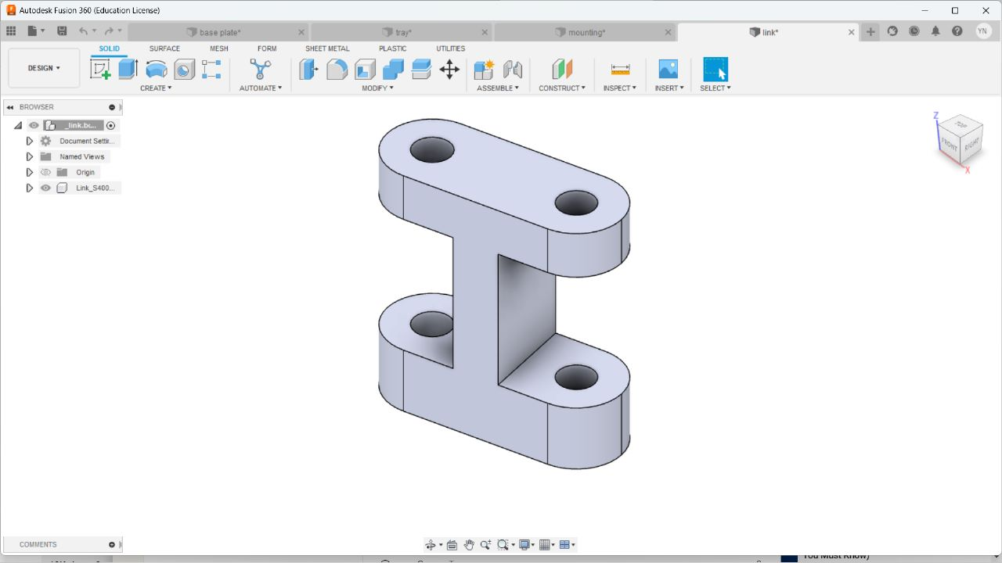
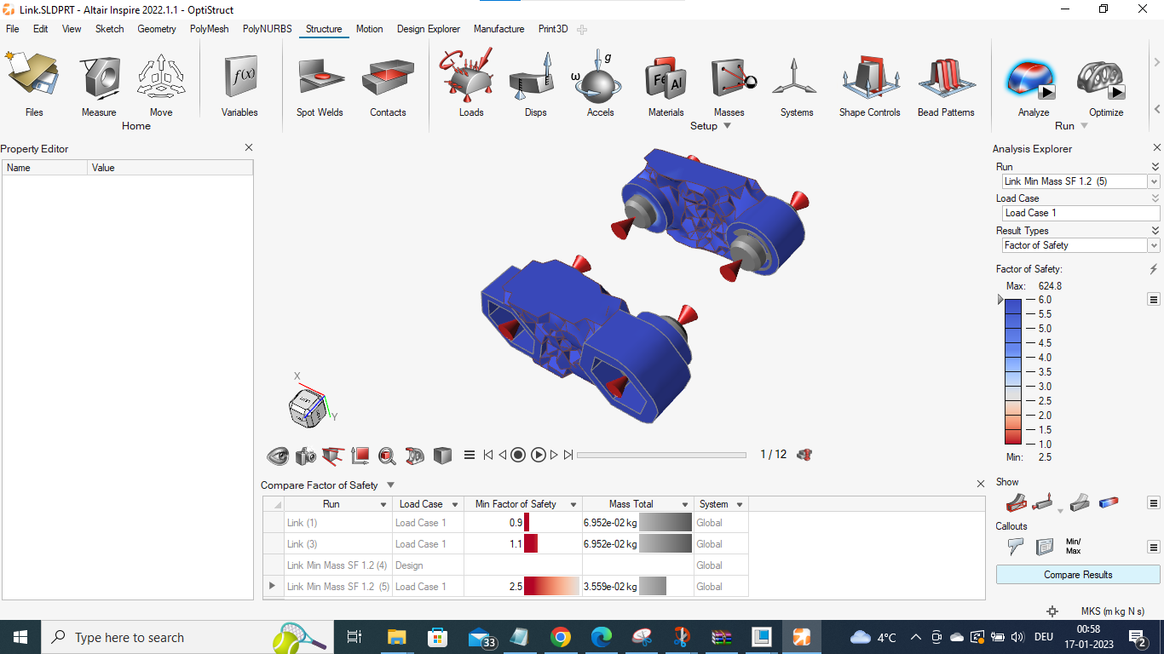
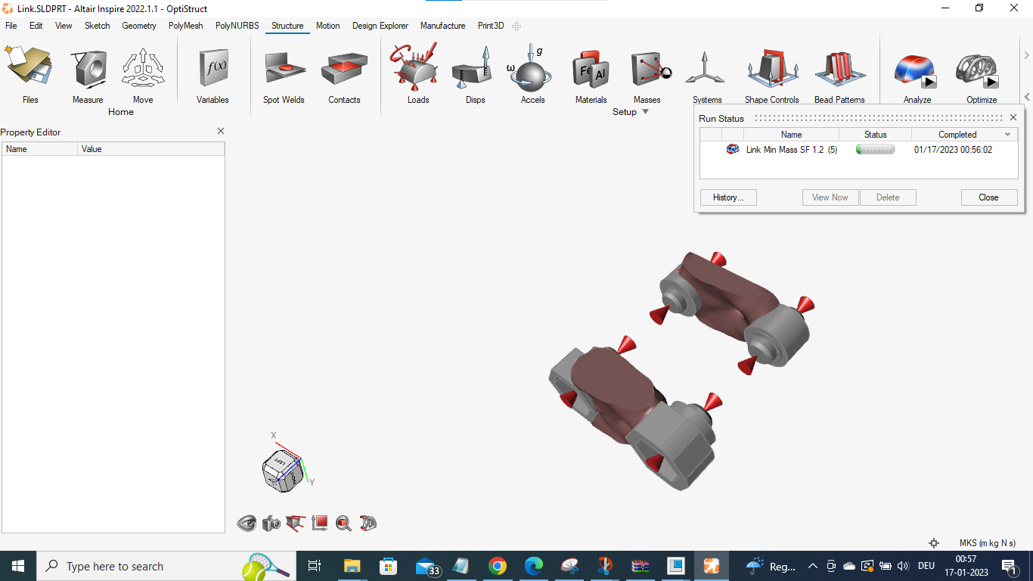
LINK
Material : Aluminium 2024 T3
Result After optimization: Decrease in mass by 48.92%
Initial Weight:
Final Weight:
3

Slide 5
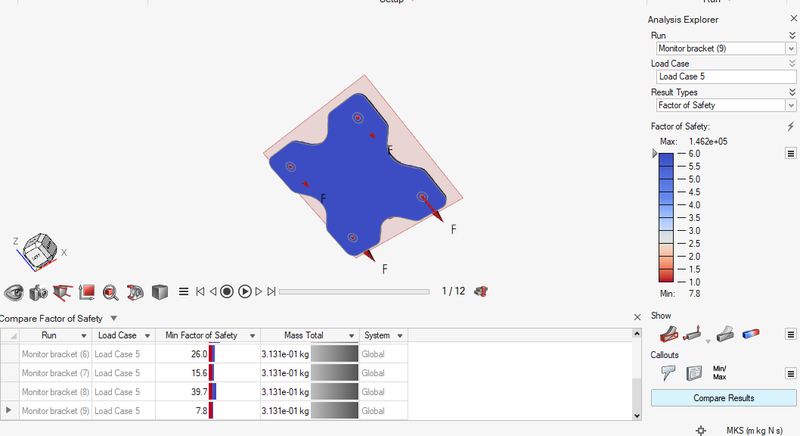
MOUNTING BRACKET
4

Slide 6


